Slide 1

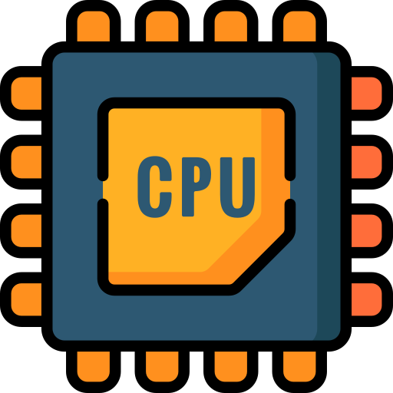
How a CPU Works? Binary, ASCII
Full-Stack Web Development Bootcamp

Slide 2



How Electricity Becomes The Brain?
Have You Every Wondered?
How does a CPU, powered by electricity, transforms an electric signal into logic? How is it able to use electricity to perform logical operations?

Slide 3

We First Need To Understand Binary
What is Binary?
In mathematics, binary refers to the base-2 number system, which uses only two digits: 0 and 1. Binary as a formal system was studied and popularized by Gottfried Wilhelm Leibniz, a German mathematician and philosopher, in the 17th century.

Slide 4
How Binary Works?
How Are Values Represented?
Decimal 0 = Binary 0000
Decimal 1 = Binary 0001
Decimal 2 = Binary 0010
Decimal 3 = Binary 0011
Decimal 4 = Binary 0100
Decimal 5 = Binary 0101
Decimal 6 = Binary 0110
Decimal 7 = Binary 0111
Decimal 8 = Binary 1000
Decimal 9 = Binary 1001
Decimal 10 = Binary 1010

Slide 5
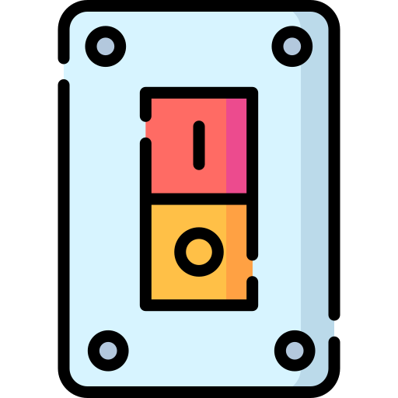
Binary Is Like A Switch?
1 - Represents On
0 - Represents Off

Slide 6
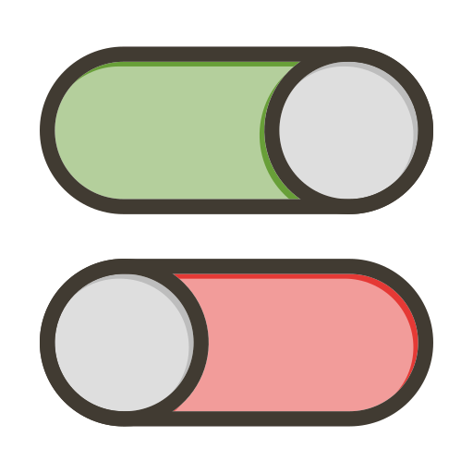
Why Does It Matter?
Each Either On or Off
Millions Of Transistors
Notes:
There is nothing magical going on inside your computer, its electricity and patterns based on these electrical signals that are processed as logical operations

Slide 7
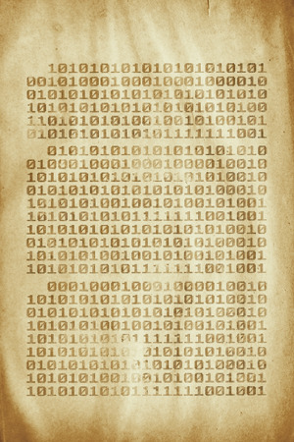
Problem - Code Was Written in Binary
Old Code In Binary
Very Difficult To Develop
Writing code in binary was difficult due to its complexity, error-prone nature, and lack of human readable syntax, making it unscalable for developing larger, more sophisticated software systems.

Slide 8
Moving Towards Standardization
A: ASCII = 01000001
B: ASCII = 01000010
C: ASCII = 01000011
a: ASCII = 01100001
b: ASCII = 01100010
c: ASCII = 01100011
ASCII (American Standard Code for Information Interchange)
ASCII (American Standard Code for Information Interchange) is a character encoding standard that assigns a numerical value to letters, digits, punctuation marks, and control characters.

Slide 9
Multiple Attempts for Standardization
ASCII (1963) American Standard Code for Information Interchange.
EBCDIC (1963) Extended Binary Coded Decimal Interchange Code.
ISO-8859 (1987) A family of 8-bit encodings by the International Organization for Standardization.
Shift JIS (1986) Developed by Microsoft and ASCII Corporation.
Unicode (1991) A universal character set designed to cover all languages and symbols.
UTF-8 (1993) Developed by Ken Thompson and Rob Pike. Variable-length encoding for Unicode, backward compatible with ASCII. The most popular encoding for the web due to its efficiency and compatibility.
UTF-16 (1996) Variable-length encoding for Unicode using 16-bit units.

Slide 10
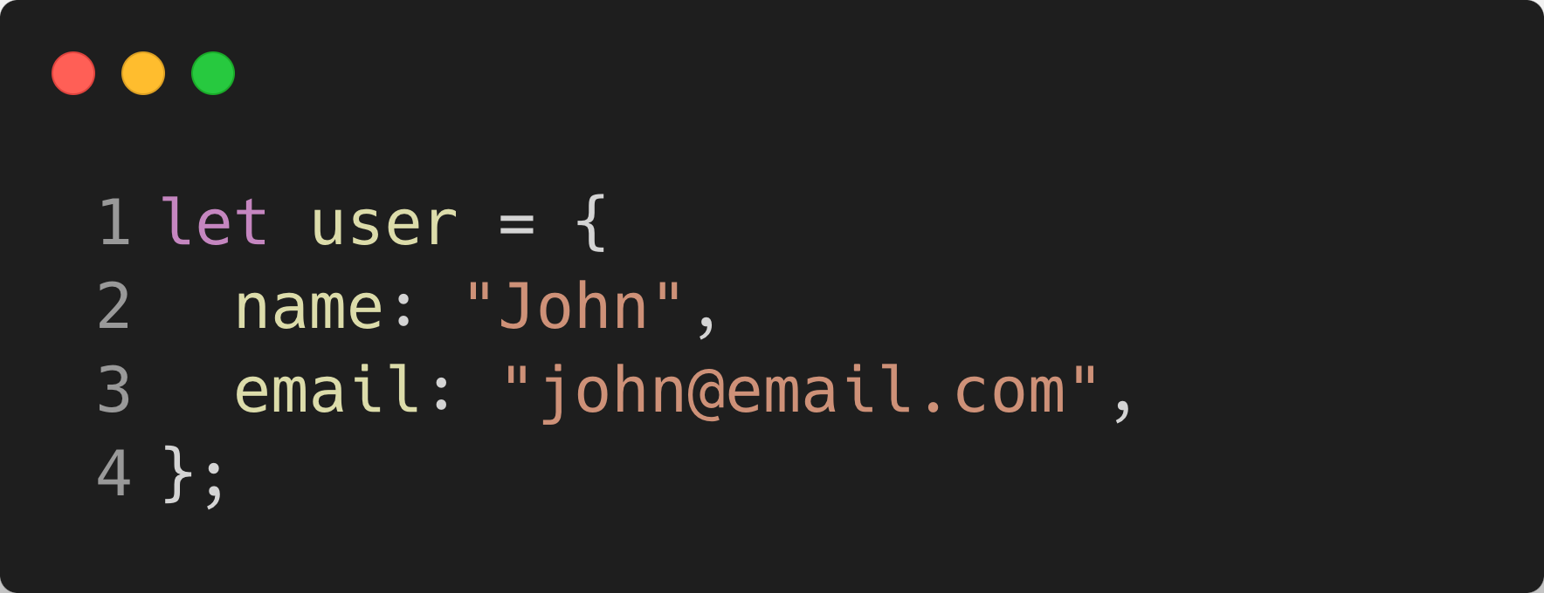
Code Could Now Be Human Readable
Because of encodings like ASCII humans could now write code in human readable syntax and computers could understand it as well.

Slide 11

How is Code Converted to Binary
Your Code
Compiler
Binary
Notes:
The computer in the end can only understand electrical signals.
Hence compiler converts all Human readable code to binary

Slide 12





High Level Programming Languages
The ability to have a compiler to compile human readable code to machine code or Binary, paved a way for creation of many high level programming languages

